Slide 1
The Shadow Brokers
An Overview of the WannaCry global ransomware attack
By Zach Weaver

Slide 2

Introduction
Hacking group that first emerged in 2016
Known for leaking classified NSA hacking tools and other exploits of some of the most dangerous malware attacks
They have had a significant impact on the cybersecurity landscape

Slide 3

History
First publicly emerged in 2016
Operated under the twitter handle @shadowbrokerss
Name comes from a MassEffect video game character
First public communication was when they auctioned off a suite of stolen hacking tools in exchange for 100 Bitcoins
Some researchers allegedly believe they were affiliated with the Russian government

Slide 4

Targets and Motivations
Main goal was to leak classified hacking information used by the NSA
They claimed they were committed to taking down the NSA
Targeted the Equation Group (offensive cyberwarfare unit of the NSA Computer Network Operations unit)
This Photo by Unknown Author is licensed under CC BY-SA

Slide 5
Equation Group
Equation Group was the Informal Name of the Tailored Access Operations (TAO) unit of the US’s National Security Agency (NSA)
Active since 1996 but gained popularity in 2008
Linked with various branches of the NSA
EG Thought to be behind the Stuxnet worm that disrupted Iran’s nuclear program
Allegedly responsible for developing incredible cyber weapons
Group was considered a secret until the Shadow Brokers came along in 2016

Slide 6
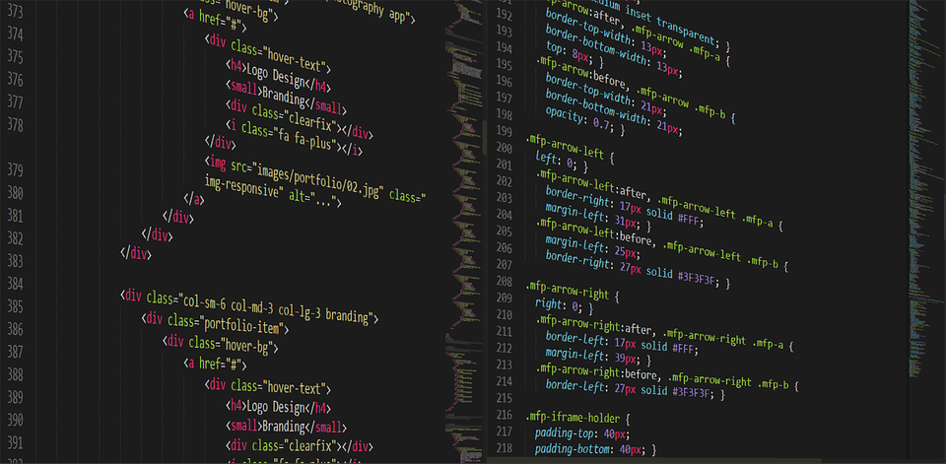
Notable Attacks – WannaCry
Ransomware attack that encrypted files of victims in over 150 countries
Shadow Brokers Held an auction for tools used by the Equation Group (EternalBlue, Eternal Romance, other exploits)
Offered a “data dump of the month” to anyone willing to pay
Released NSA tools onto the internet (including attack campaigns from 2000 – 2013)

Slide 7
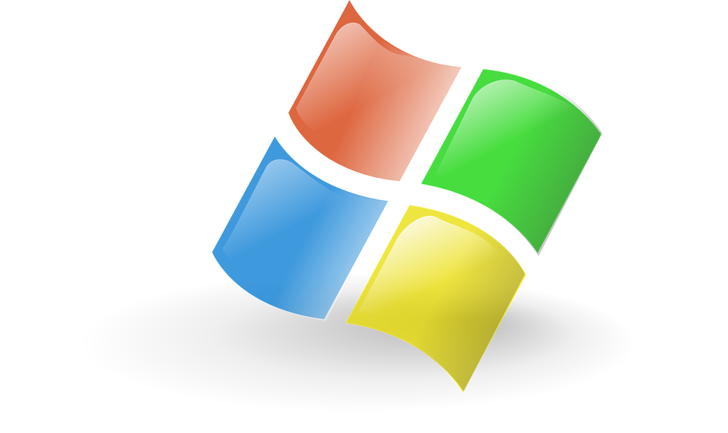
Eternal Blue
Windows exploit created by the NSA
Exploits a vulnerability in the Microsoft SMB protocol
Caused unpatched Windows machines to allow illegitimate data packets into a legitimate network (containing malware)
NSA did not alert Microsoft about EternalBlue’s existence for five years (until data leak)

Slide 8
Responses and Consequences
Shadow Brokers appeared to have unrestricted access to the NSA
Went on to reveal many servers and tools used by the Equation Group
Edward Snowden speculated that they conduced a “reverse hack” using Eternal Blue and similar tools (backdoor into NSA)
Microsoft went on to share a security patch for Windows sysadmins
Since the initial attack, the Shadow Brokers have gone silent
Origins and Identities still unknown

Slide 9
References
https://www.hypr.com/security-encyclopedia/shadow-brokers
https://securityscorecard.com/blog/what-is-equation-group-shadow-brokers/
https://www.avg.com/en/signal/the-most-dangerous-hackers-today
https://www.microsoft.com/en-us/security/blog/2017/06/16/analysis-of-the-shadow-brokers-release-and-mitigation-with-windows-10-virtualization-based-security/

